Slide 1
Capstone Project Health Insurance Cross Sell Prediction ML Supervised Classification
Team members
Md Kamran
Reena Verma
Mithin Barde
Rishab Gupta
Krunal Sonare

Slide 2
Table Of Contents
Problem Statement
Data Summary
Data Cleaning
Data Visualization
Feature Selection
Model Selection( Implemented Various Classification Algorithms )
Hyperparameter tuning
Conclusion

Slide 3
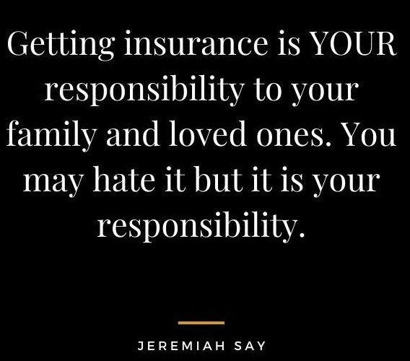
Understanding Insurance
What is an insurance policy ?
How it works ?

Slide 4
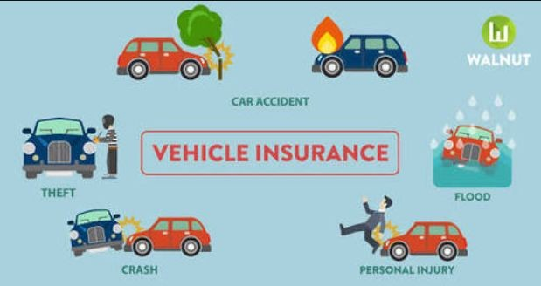
Problem Statements
To Prediction whether a customer will buy insurance(vehicle) or not.

Slide 5
Data Summary
id: Unique ID for the customer
Gender: customers’ gender
Age: The age of the customer
Driving_License: Customer is having a driving license or not
Region_Code: Unique code for the region
Previously_Insured: Whether the customer has been insured previously or not
Vehicle_Age: Age of the Vehicle
Vehicle_Damage: Is the customer got his/her vehicle damaged in the past
Annual_Premium: The amount customer needs to pay as a premium in the year
PolicySalesChannel: Anonymized Code for the channel of outreaching the customer that is Different Agents, Over Mail, Over the Phone, In Person, etc.
Vintage: Number of Days, Customer has been associated with the company
Response: The customer is interested or not

Slide 6
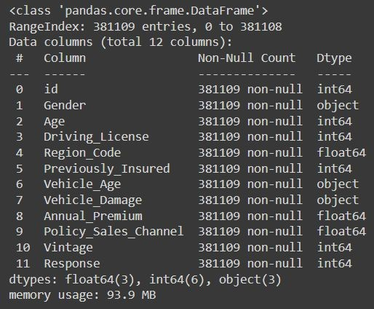
Basic Data Exploration
The dataset has 381109 observations and 12 features(columns).
Three categorical features `Gender’ , ‘Vehicle_Age’ , ‘Vehicle_Damage’
No Missing Values.
No Duplicate values.

Slide 7
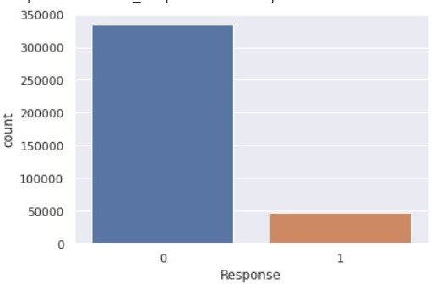
Target Column countplot Data is highly imbalance

Slide 8
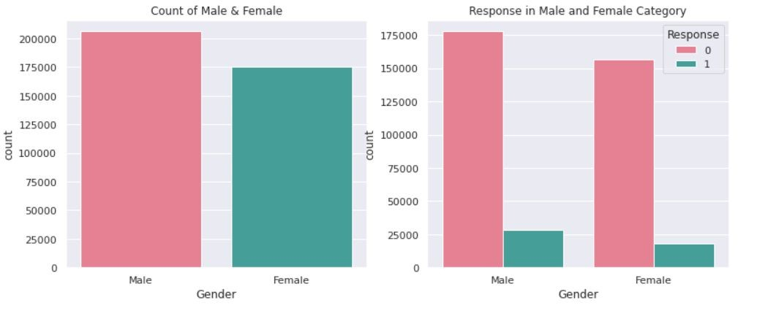
Gender
From the 1st graph, I can say that The gender variable ratio in the dataset is almost equal, the male category is slightly more than the female and the chances of buying insurance is also a little higher than the female. The number of males is greater than 200000 and The number of females is close to 175000.
From the 2nd graph we can say that The number of males interested is greater than 25000 and The number of females interested is below 25000. The male category is slightly greater than that of female and the chances of buying the insurance is also a little high

Slide 9
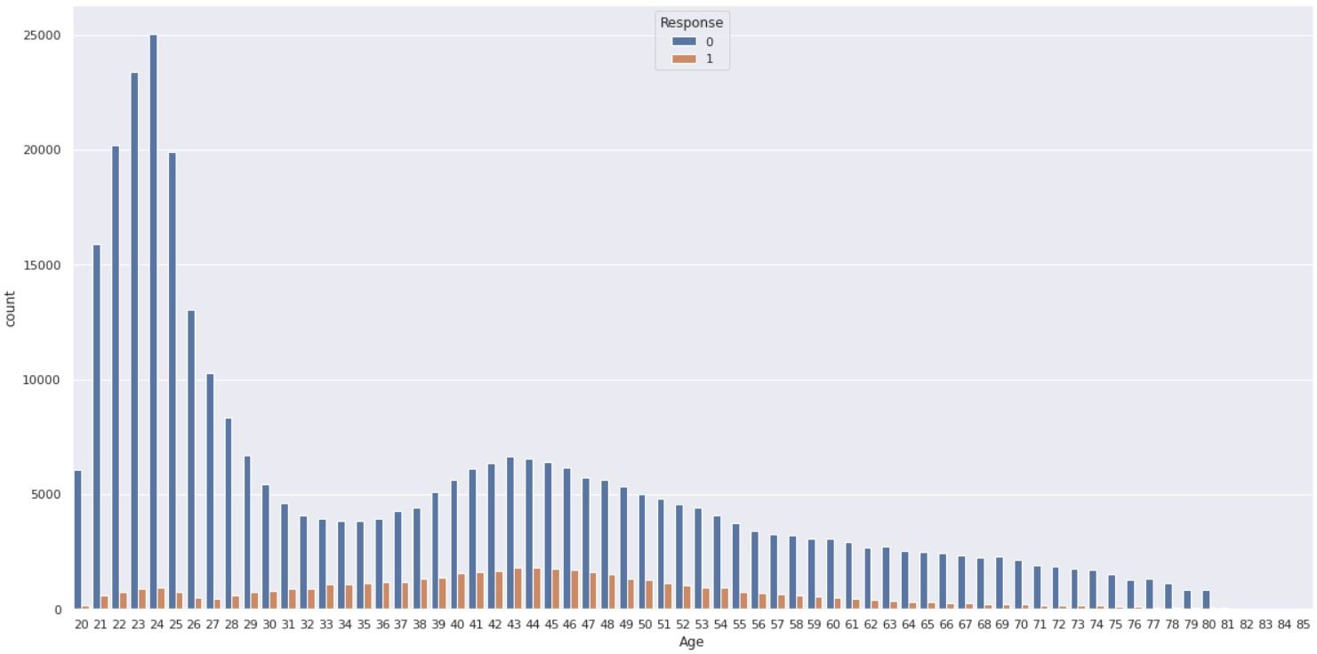
A g e c o u nt p l o t

Slide 10
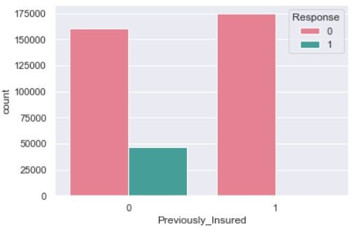
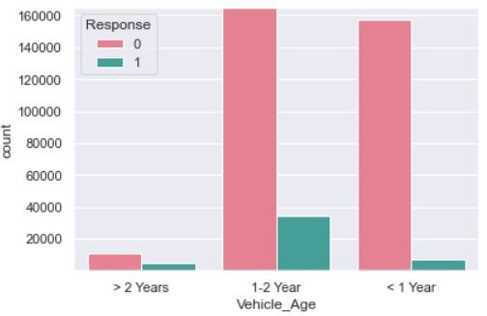
Data Visualization
We can conclude that those who have not insurance some of them are taking insurance
From the above graph, we can clearly say that if the vehicle age is in between 1 to 2 year they are taking more insurance than others.

Slide 11
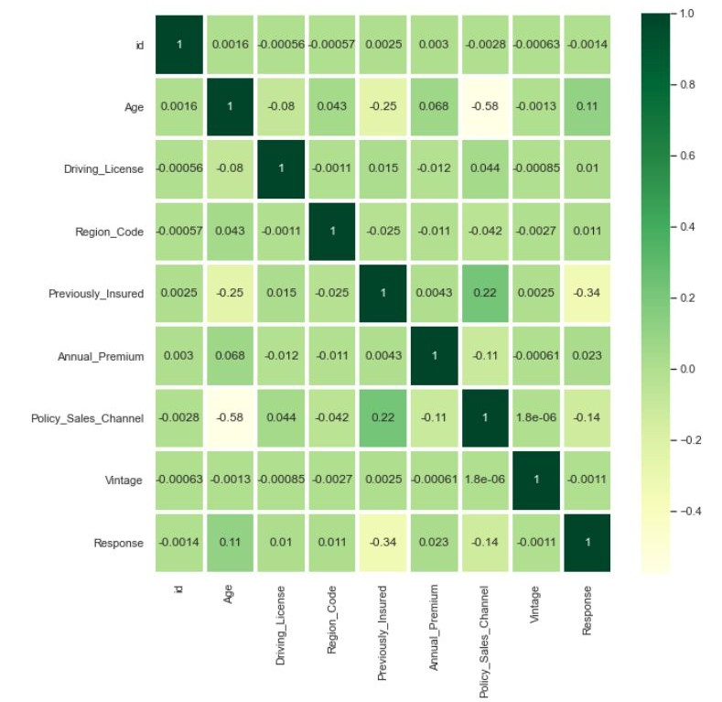
Correlation Matrix
As you can see the target variable(Response) is not highly correlated with any dependent variable.

Slide 12
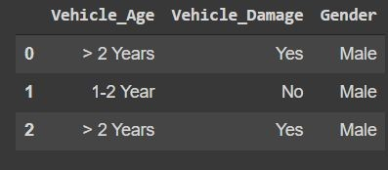
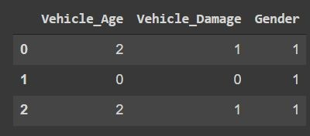
Data Cleaning & Preparation
Converted
Categorical
Columns

Slide 13
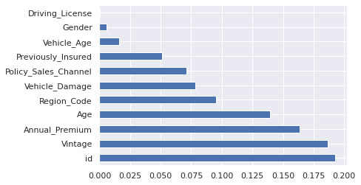
Feature Selection
As you can see previously insured and vehicle damage is contributing most
But, Driving license , Annual Premium , Gender contributing least
Dropping these columns :- Driving_License' , 'Vehicle_Age_> 2 Years', Gender_Male

Slide 14
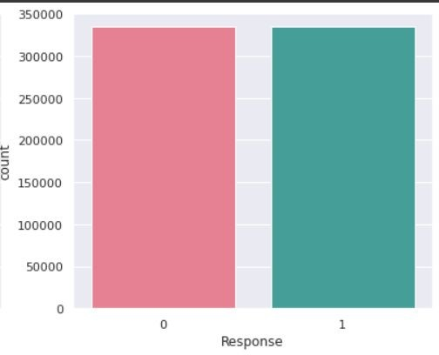
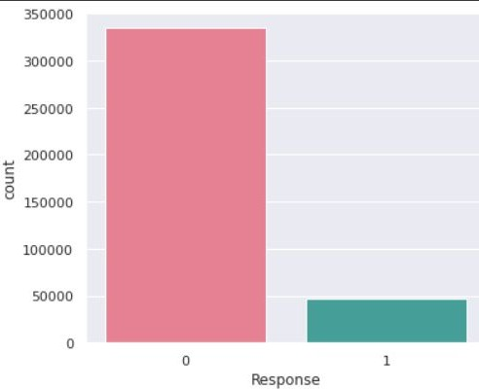
Data Preparation ( part1 )
Using RandomOverSampler to resample because as you can see the data is highly imbalanced

Slide 15
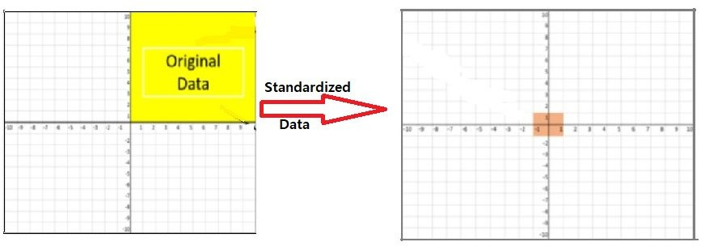
Data Preparation (part2)
Label Encoding
Train Test Split ( test_size = 0.2 , random_state = 1)
StandardScaler

Slide 16
Model Selection
This problem can be identiﬁed as Binary Classiﬁcation (wheather customer opts for vehicle insurance or not)
Dataset has more than 300k records
Cannot go with SVM Classiﬁer as it takes more time to train as dataset increase
Models we will be using here are:
Logistic Regression
Random Forest
XGBClassiﬁer

Slide 17
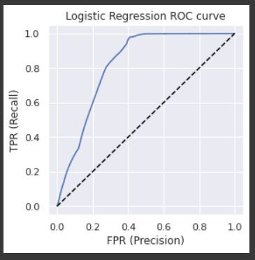
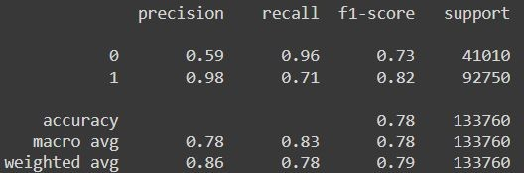
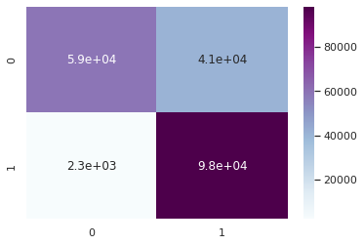
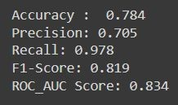
1.Logistic Regression
ROC Curve
Classification Report
Confusion Matrix
Test Dataset details

Slide 18
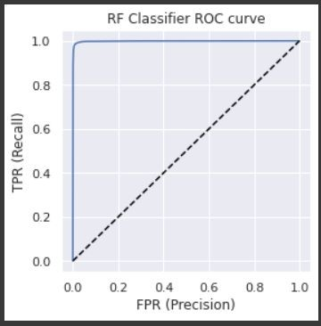
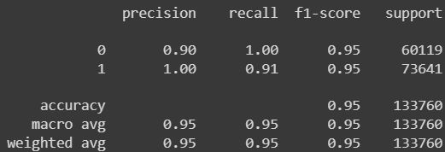
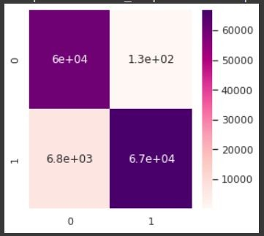
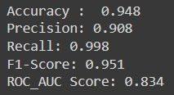
2. RandomForestClassifier
ROC Curve
Classification Report
Confusion Matrix
Test Dataset details

Slide 19
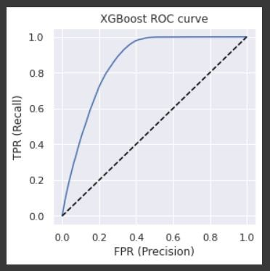
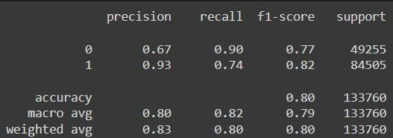
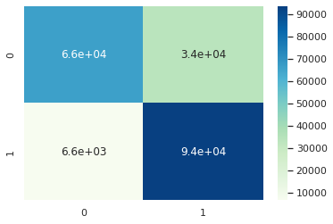
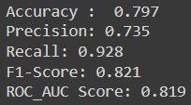
3.XGBClassifier
ROC Curve
Classification Report
Confusion Matrix
Test Dataset details

Slide 20
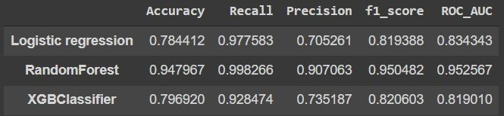
Let’s compare those models
Will select RandomForest as final model

Slide 21
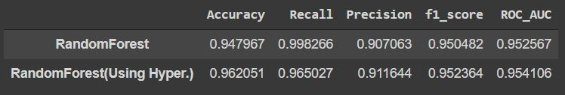
H y p e r p a r a m e t e r T u n I n g
Used GirdSearchCV
Best hyperparameter values:
criterion: gini
max_depth: 50
min_samples_split : 2
n_estimators: 10

Slide 22
Conclusion
The ML model for the problem statement was created using python with the help of the dataset(contains more than 300k observations)and RandomForestClassiﬁer performed best among those three models (Logistic Reg. , XGBClassiﬁer , RandomForestClassiﬁer ).
Thus, for the given problem, the models created by Random Forest is preferred.
Notes:-
Customers of age between 30 to 60 are more likely to buy insurance.
Customers with Driving License have higher chance of buying Insurance.
Customers with Vehicle_Damage are likely to buy insurance.
The variable such as Previously_insured , Vehcile_Damage are more affecting the target variable. 5 The variable such as Driving_License , Gender are not affecting the target variable.
6. comparing ROC curve we can see that Random Forest model perform better. Because curves closer to the top-left corner, it indicate a better performance.

Slide 23


